Slide 1


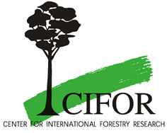

Monitoring, Reporting and Verification of Carbon Benefits in Agriculture and Forestry
David L. Skole
Professor of Forestry and Global Change Science
Michigan State University
“Linking carbon benefits and livelihoods”

Slide 2
Linking carbon and development
An approach: increasing the amount of carbon in soil and biomass for small holder systems…
…also increases biodiversity and farmer incomes
  carbon sequestration in the adoption of afforestation, reforestation, sustainable land use, agroforestry and related livelihood activities;
  afforestation, reforestation, sustainable land use and agroforestry as adaptation strategies for climate change;
  additional co-benefits related to biodiversity conservation and other environmental concerns, livelihoods and poverty reduction (i.e., sustainable development); and
  direct participation in the globalization phenomenon of hundreds of millions people in developing, and least developed, countries.

Slide 3
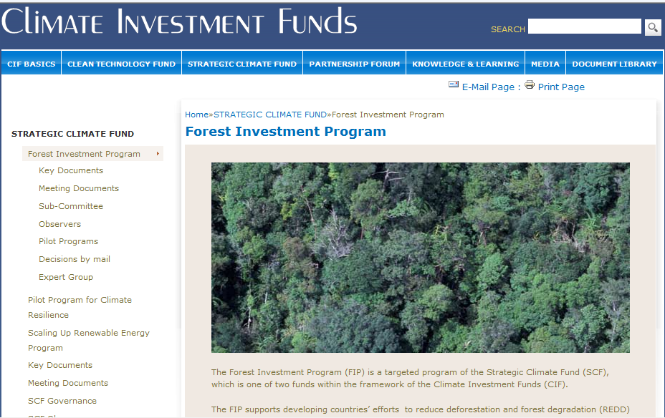

Slide 4
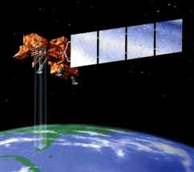
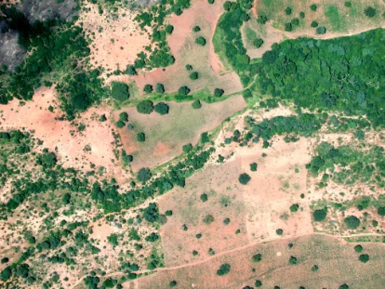
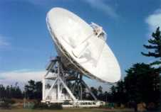
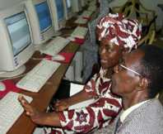
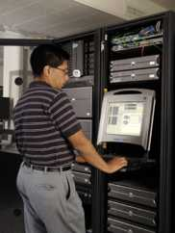

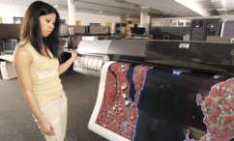


Ground
measures
Local
communities
TRFIC Technologies
Carbon2Markets tools
Remote measures
WWW
Satellite – ground
integration
GEF (markets)
Analysis

Slide 5
Three Core Applications
Carbon Accounting for LULUCF
  Baseline, ex ante calculations, measurements, monitoring, reporting
  Project based, scalable to millions of hectares
  Reduces transaction costs
Tropical Forest Monitoring: Deforestation Measurement
  Fine spatial resolution, national to continental scale
  Supports REDD+ and related needs
Carbon Monitoring and Evaluation, Carbon Risk Assessment
  Project or portfolio based
  Reporting on land use project’s carbon impact
  Regular and global application and reporting

Slide 6
INPUT PARAMETERS
IPCC Default
National Inventory
Models
Project Parameters
Earth Obs.
Pre-Analysis
Inventory, Proj. Design
MOD1
Inventory
Ex Ante
Modeling
PDD
CB Score
Index
Rating
Other Certs
MEASUREMENTS
Allometry
Functional Branch
Crown
Dendro
Density
Fire
MAI, NPP
MOD2
A, R, AF
Protocol, Project, Mrkts,
Targeted Measurements
MRV
Monitoring
Rpt
Verif
$
…
MEASUREMENTS
Biomass
C Stocks
DISTURBANCE
Deforest.
Degrad., Logging
MOD3
REDD+
T=0
T=0+n
Eval. & Assessments
MEASUREMENTS
Allometry
Functional Branch
Crown
Dendro
Density
Fire
MAI, NPP
Landscape Surveillance
MRV
Monitoring
+
Assessment
CB Score
Index
Rating
Other Certs
MOD4
CB RATING
…
T=0
T=0+n

Slide 7
Cost effectiveness
Covering large areas with image acquisitions
Spatial resolution from 30 m down to 0.5 m
Can capture large forest tracts or small holder fields in same imagery
REDD monitoring: Estimates to-date are $0.20 per km2 or $0.002 per ton CO2e biomass or $0.006 per ton CO2e emission
Sequestration projects: Estimates to-date are $1.00 per ha or $0.11 per ton CO2e
Once basic investments are made – e.g. carbon maps, tree planting, capacity building

Slide 8
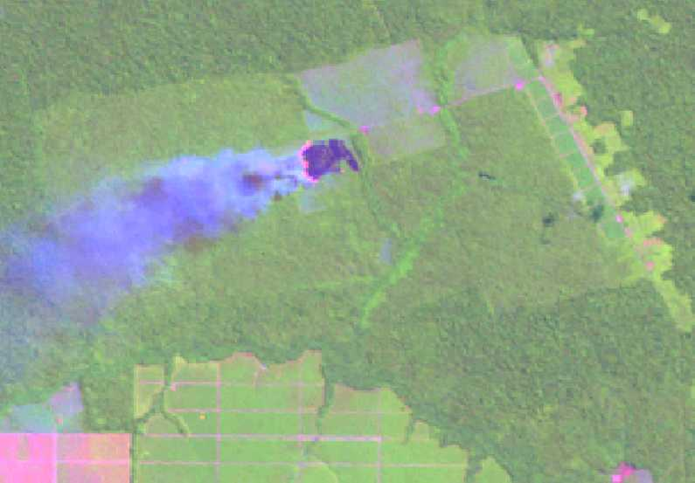
Applying Remote Sensing REDD
Forest
Burning
Slashed
Agriculture, grass
Agriculture, bare soil

Slide 9
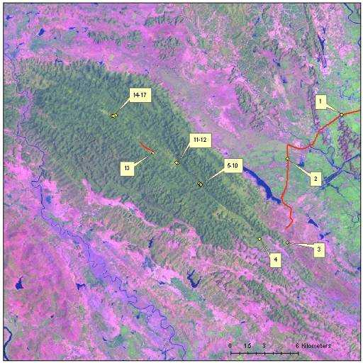
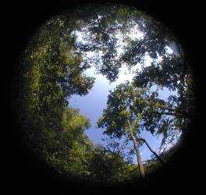
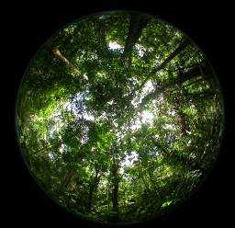
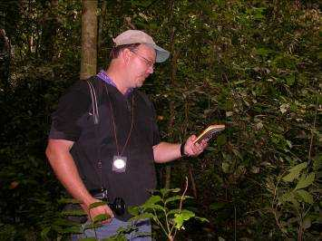
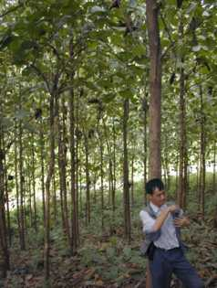
In Situ: GPS, Digital Photos, Forest Mensuration (DBH, height, etc)

Slide 10
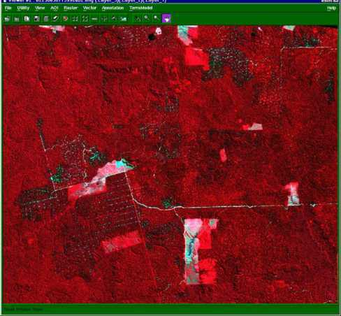
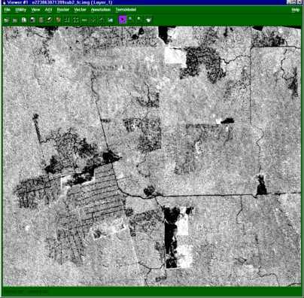
Continuous Fields Degradation
Satellite Image
Biomass-Carbon Intrepretation
50-60%
80%
100%
60-80%

Slide 11
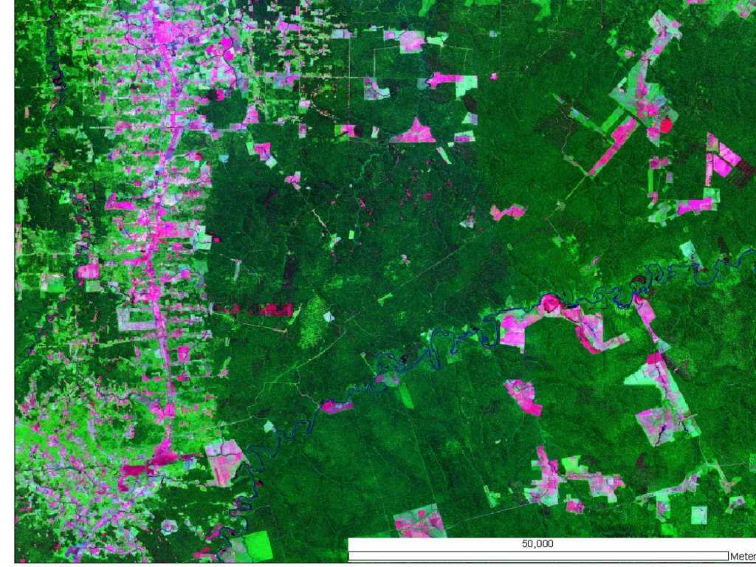

Slide 12
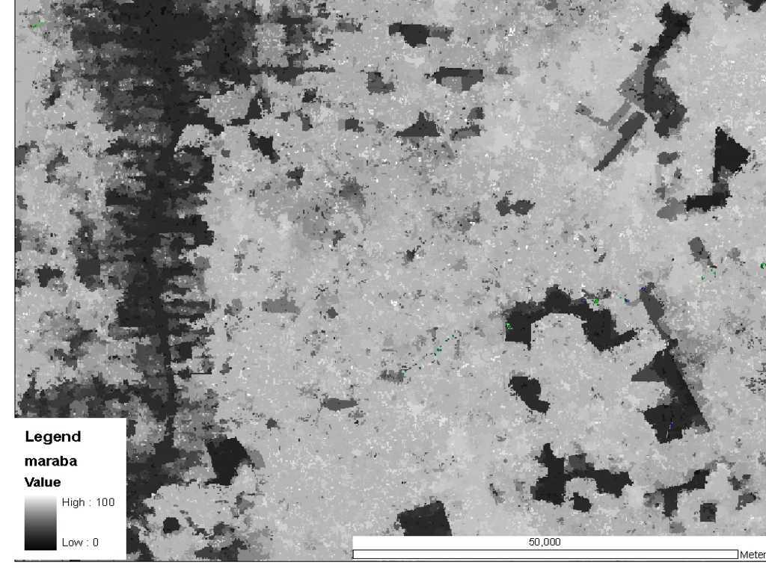

Slide 13
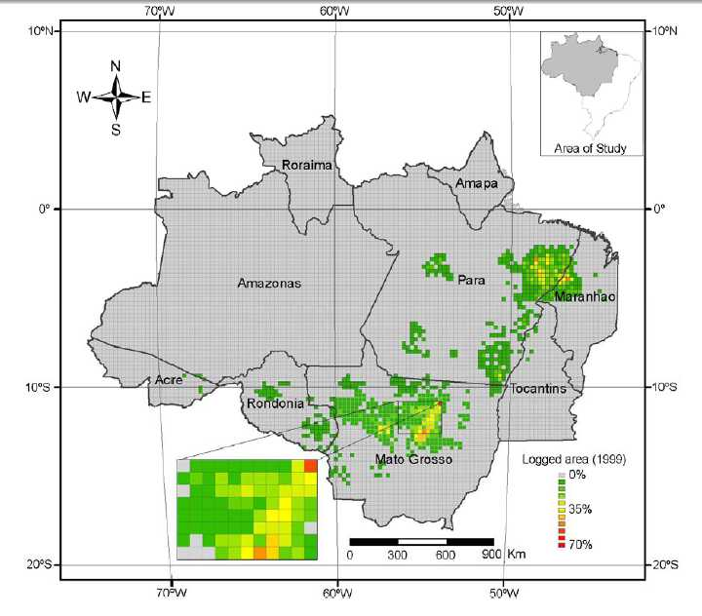
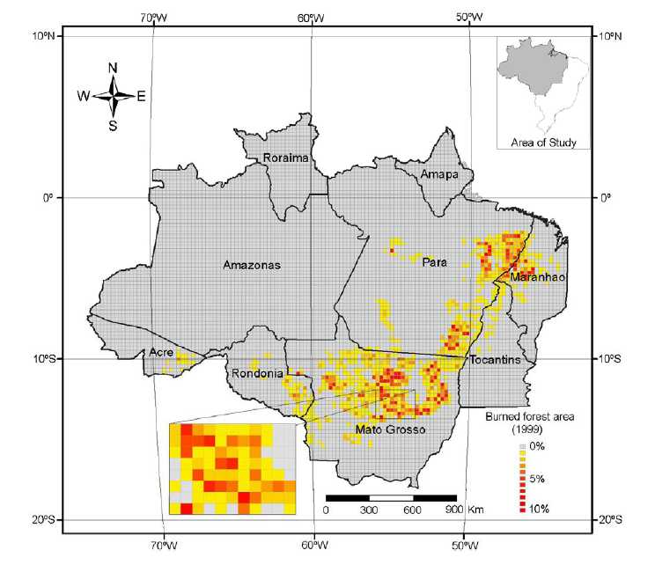

Slide 14
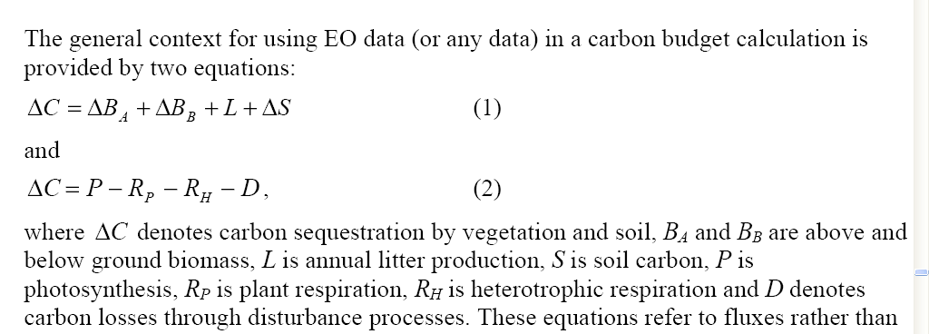
Carbon Measurement

Slide 15
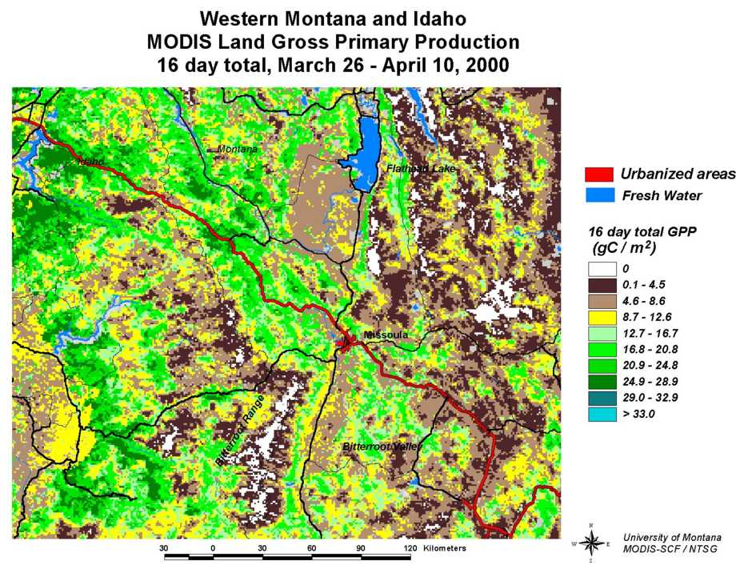

Slide 16
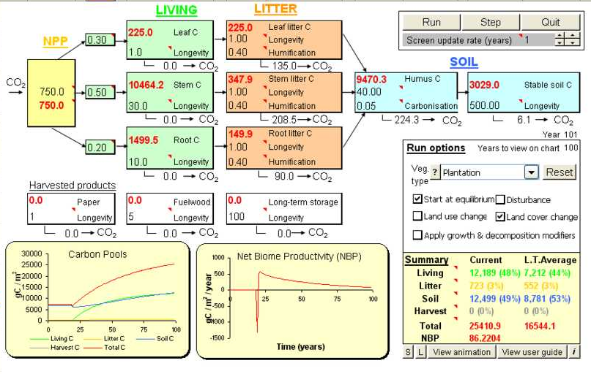
Linking remote sensing to C models and databases

Slide 17
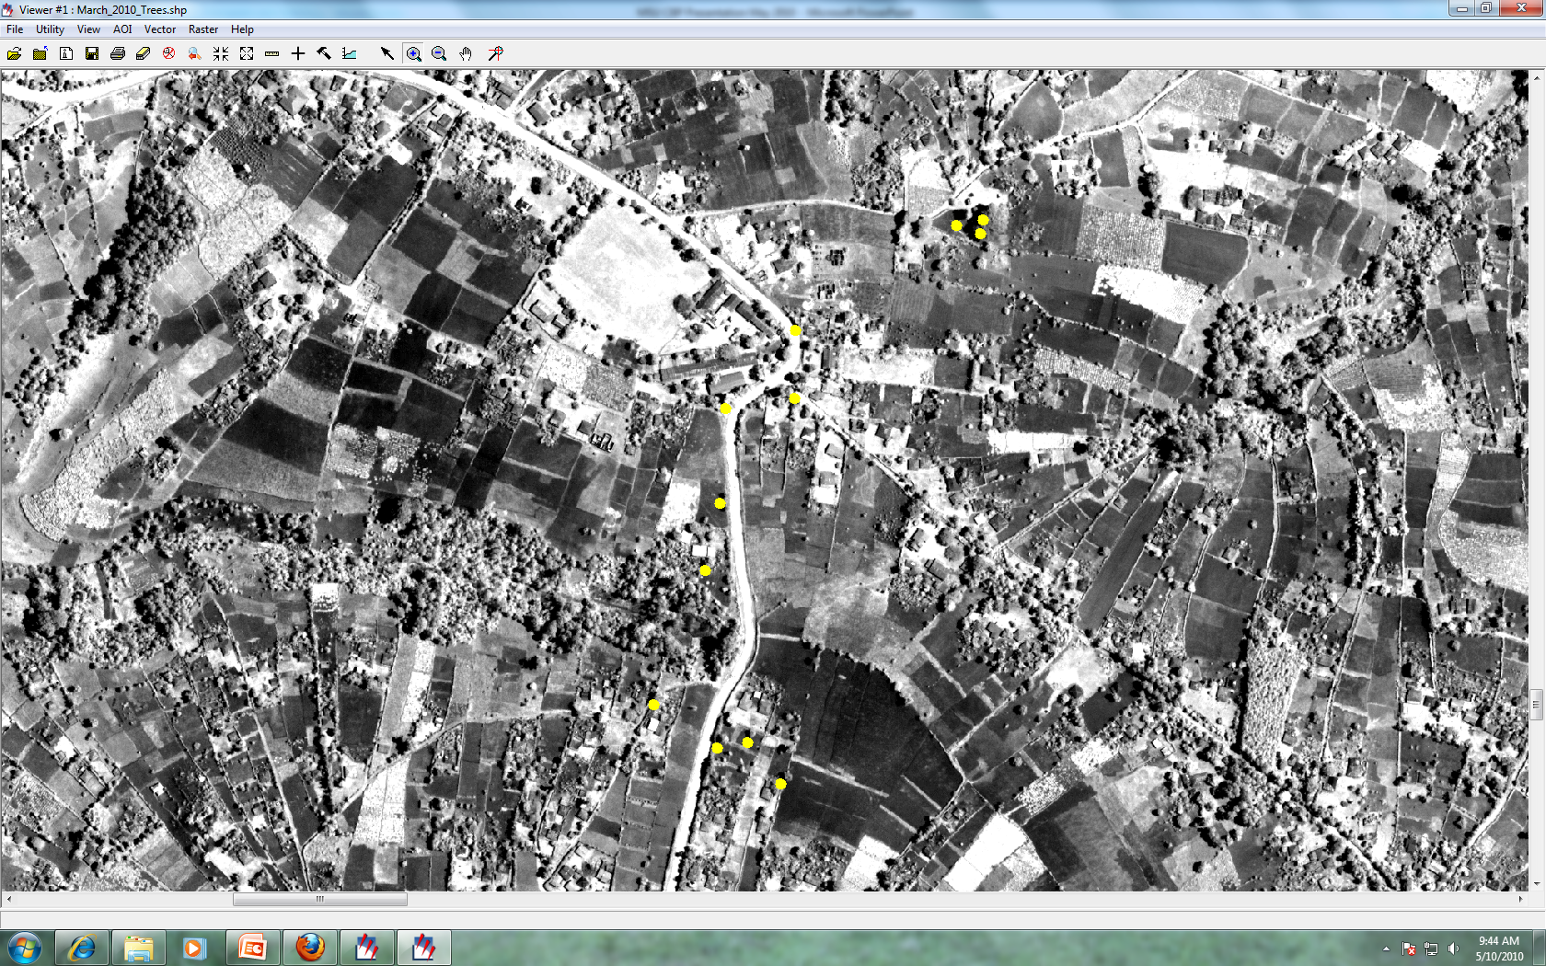

Slide 18
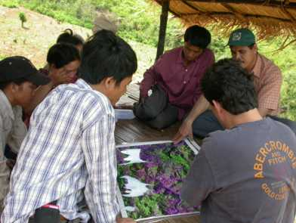
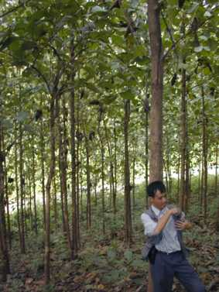
Ground calibration is essential
Our methods and technologies provide the basis for accounting and reporting carbon for projects at the local scale.

Slide 19
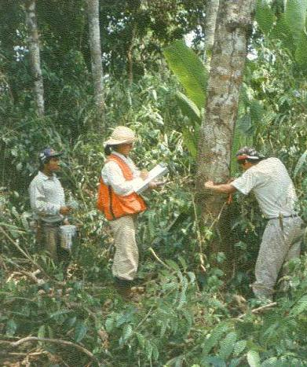
Estimate carbon pools - tree biomass
In each strata, measure DBH of appropriate size trees
DBH measured at 1.3 m above the ground with a DBH tape

Slide 20
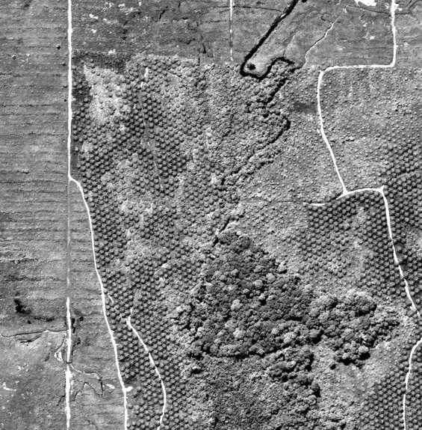
Integration of in situ carbon with imagery
Plantation plot
samples
New trees
Mature tress

Slide 21
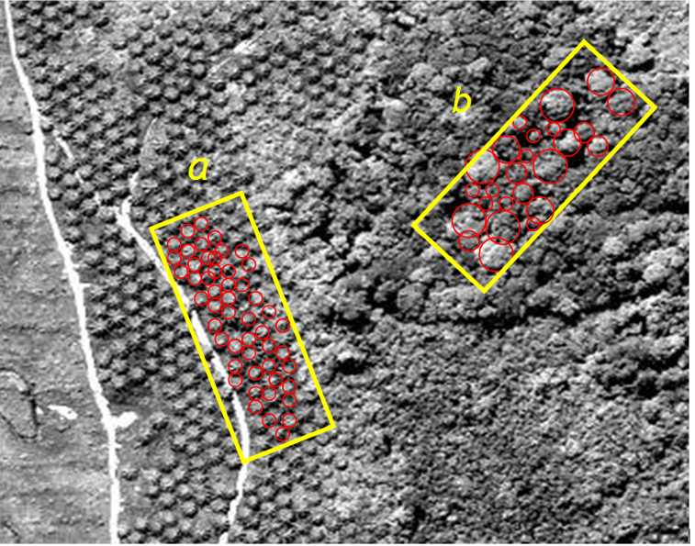
Hyper-rez tree crown detection

Slide 22
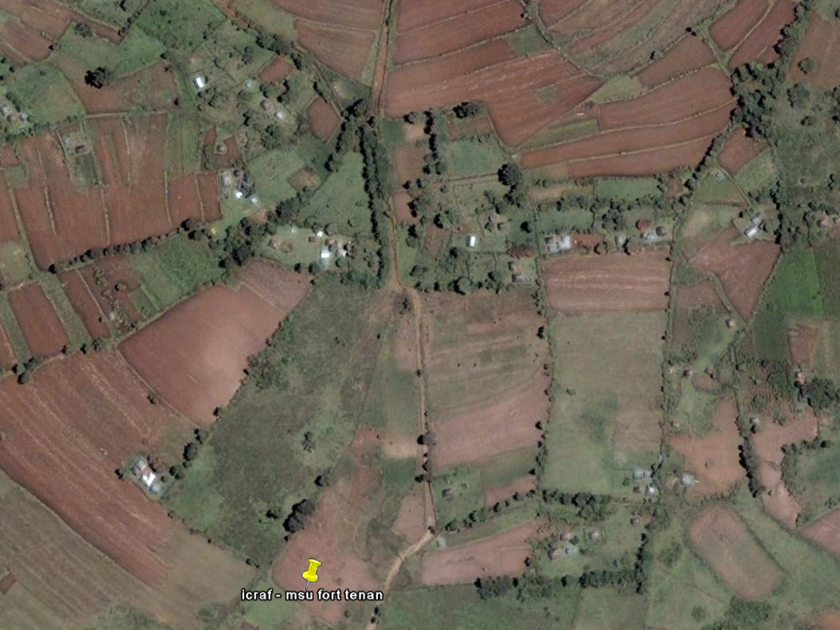
Western Kenya

Slide 23
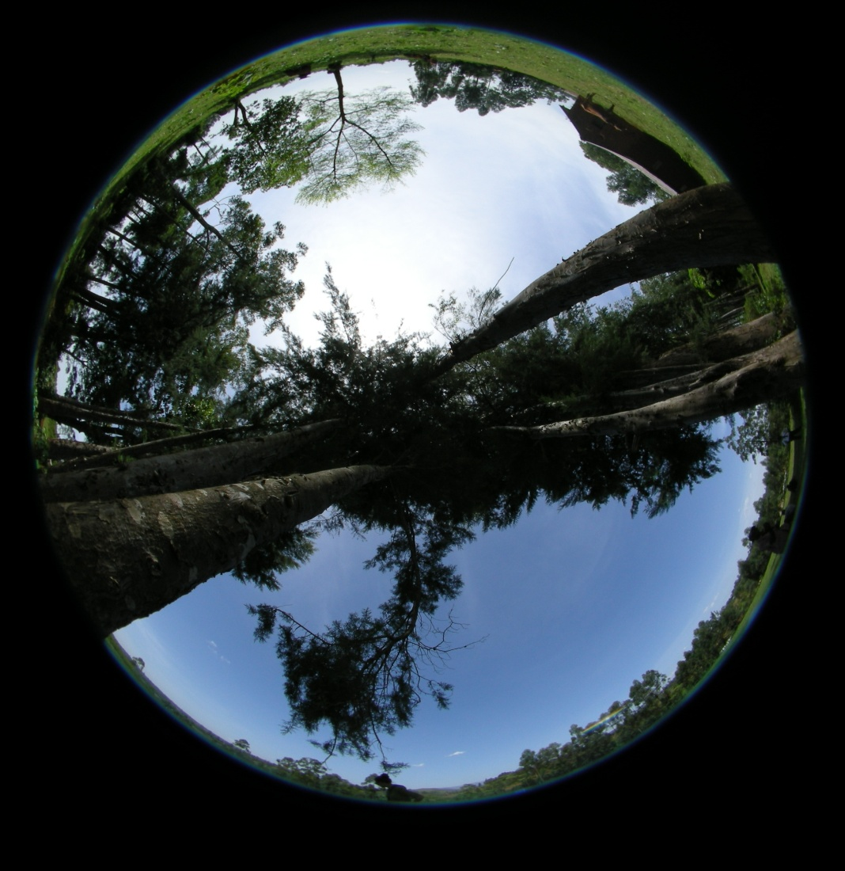
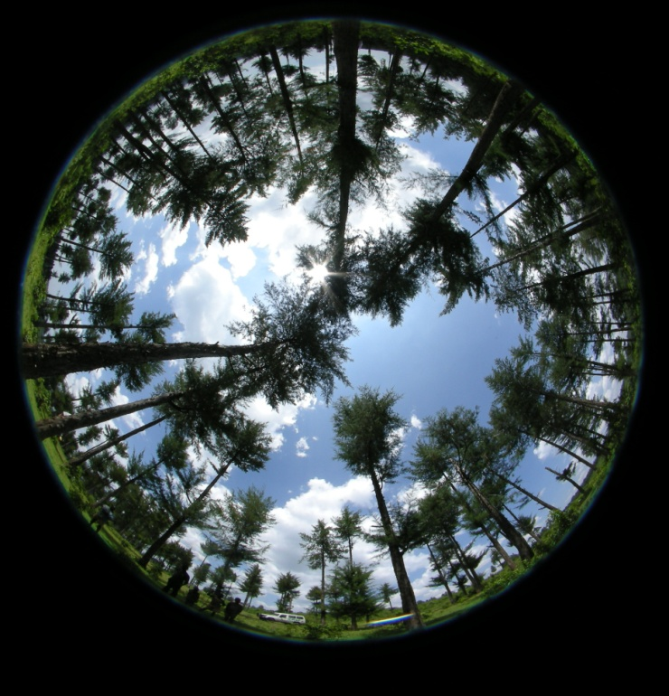
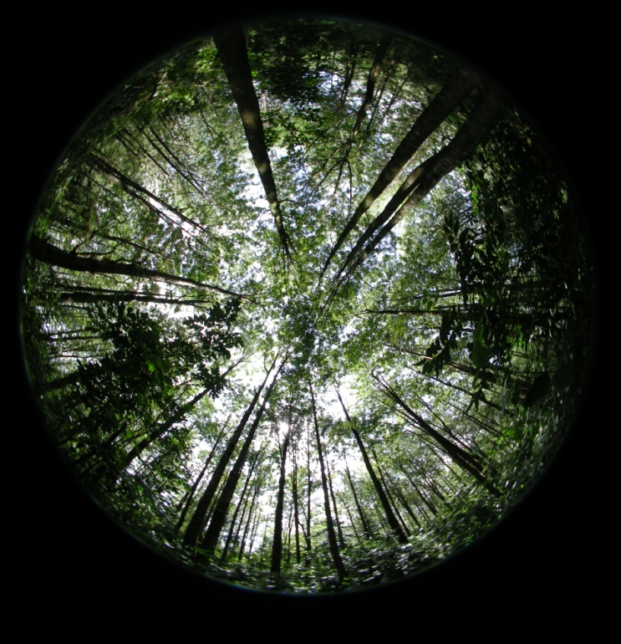
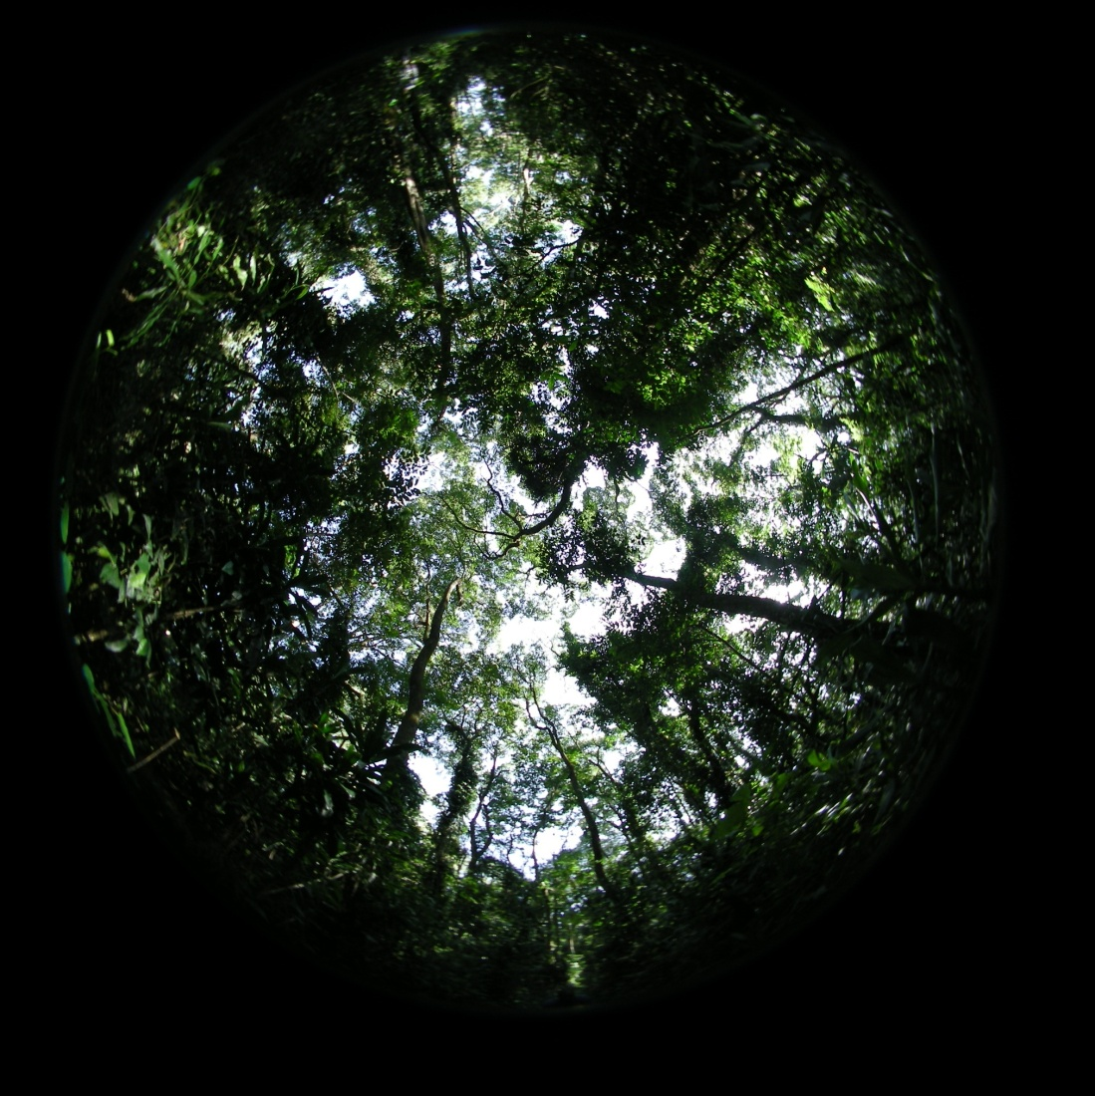
Cupressus lusitanica fencerow
(57% cover)
Thinned
Cupressus lusitanica plantation
(62% cover)
Grevillea
robusta plantation
(75% cover)
Kakamega
Forest
(84% cover)

Slide 24
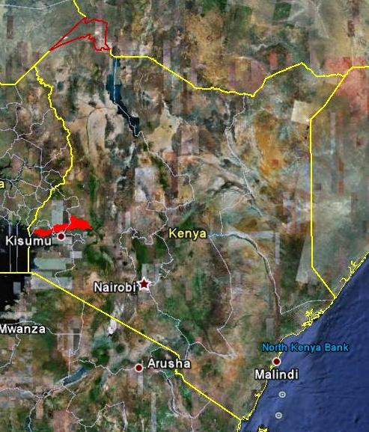
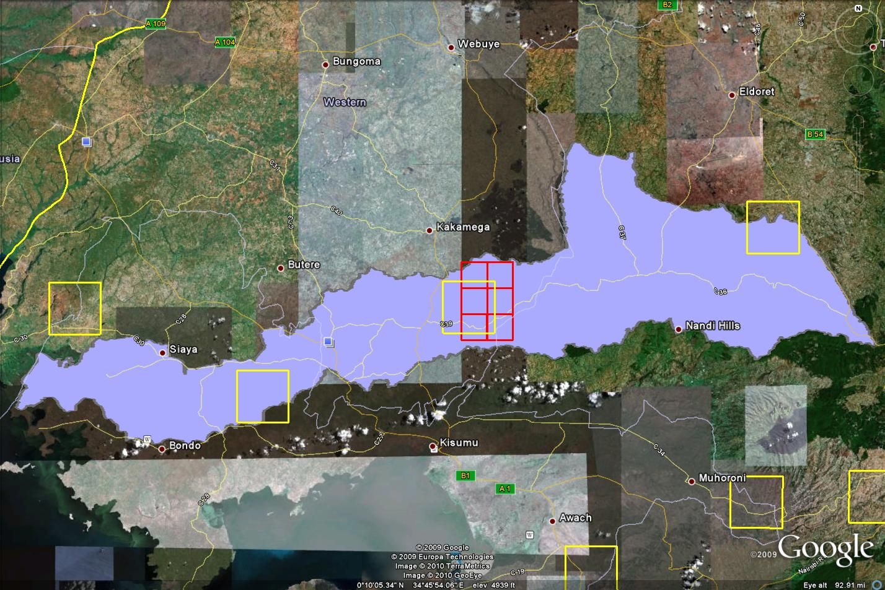
Yala Watershed in Western Kenya
Illustrating the CBP Protocols in Western Kenya
Yala Watershed – 3,351 km²
Yellow boxes – prior WKIEMP sites
Red rectangle – 2009 Quickbird imagery
Yala
Watershed

Slide 25
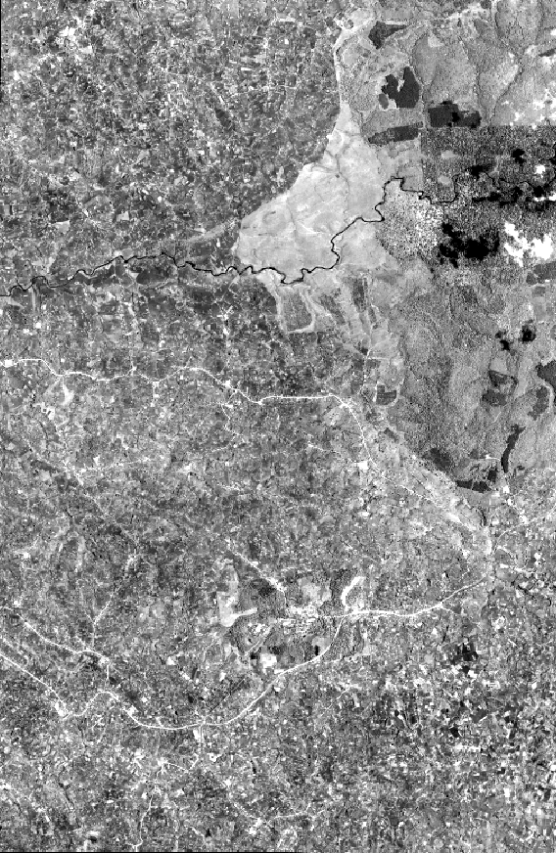
Quickbird satellite image
14 March 2009
149 km² coverage
0.6 m PAN resolution
2.4 m MSS resolution
Agriculture and Kakamega Forest

Slide 26
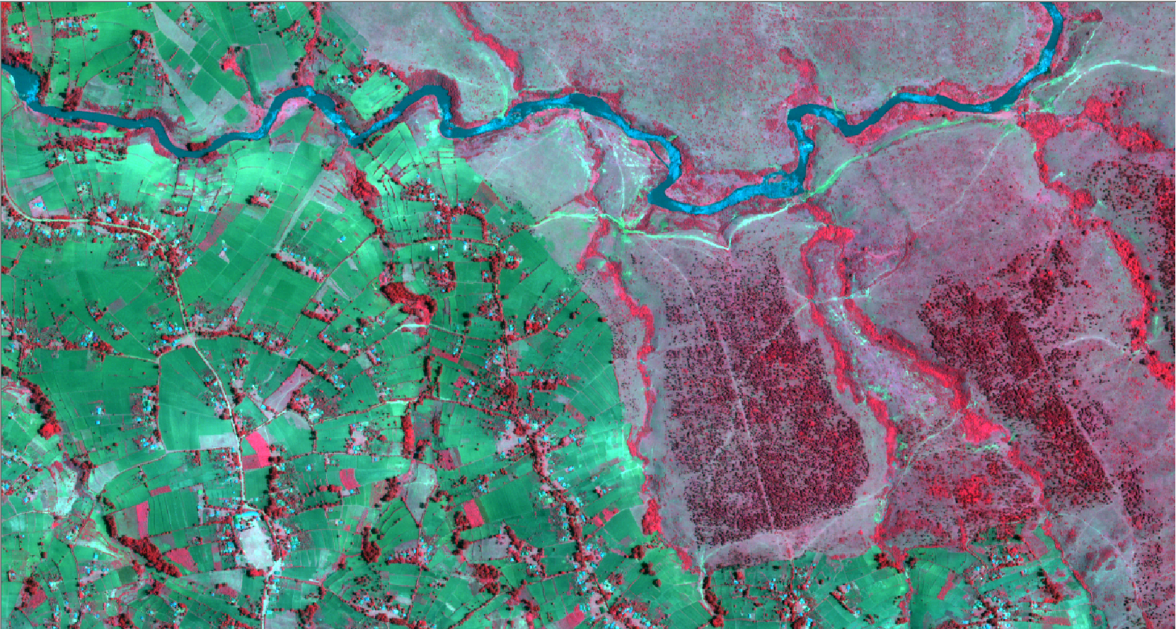
2.4 m MSS Quickbird Image: Yala River, boundary of legal forest, cypress plantations, fencerows, woodlots, farm fields

Slide 27
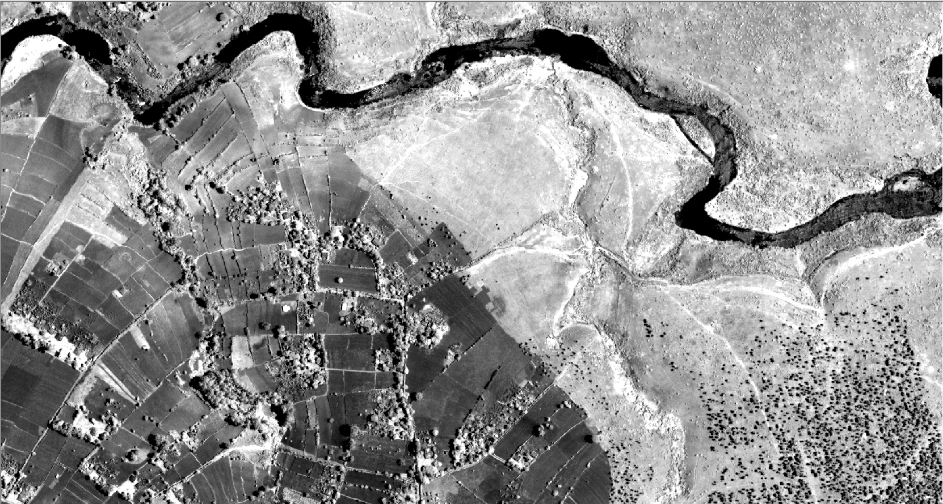
0.6 m PAN Quickbird image of Yala River

Slide 28
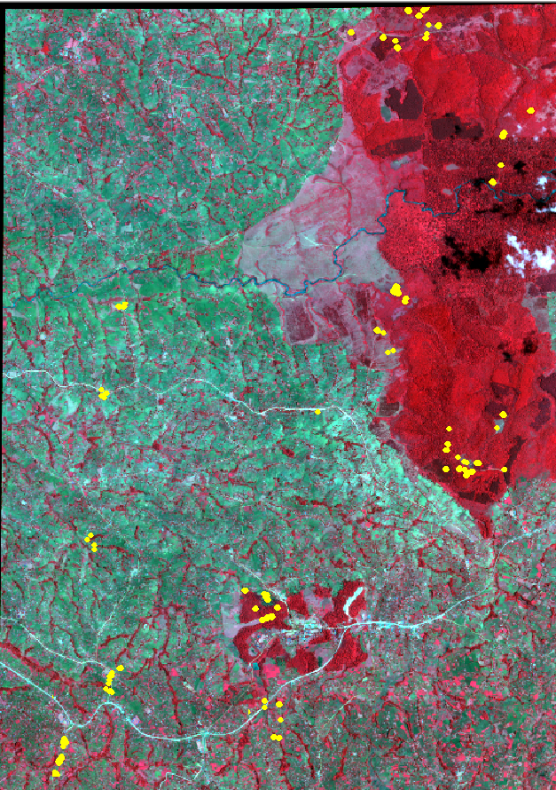
108 sample plots: agriculture (trees on farms) fencerows natural forests early succession stands broadleaf plantations conifer plantations agroforestry demo sites individual trees

Slide 29
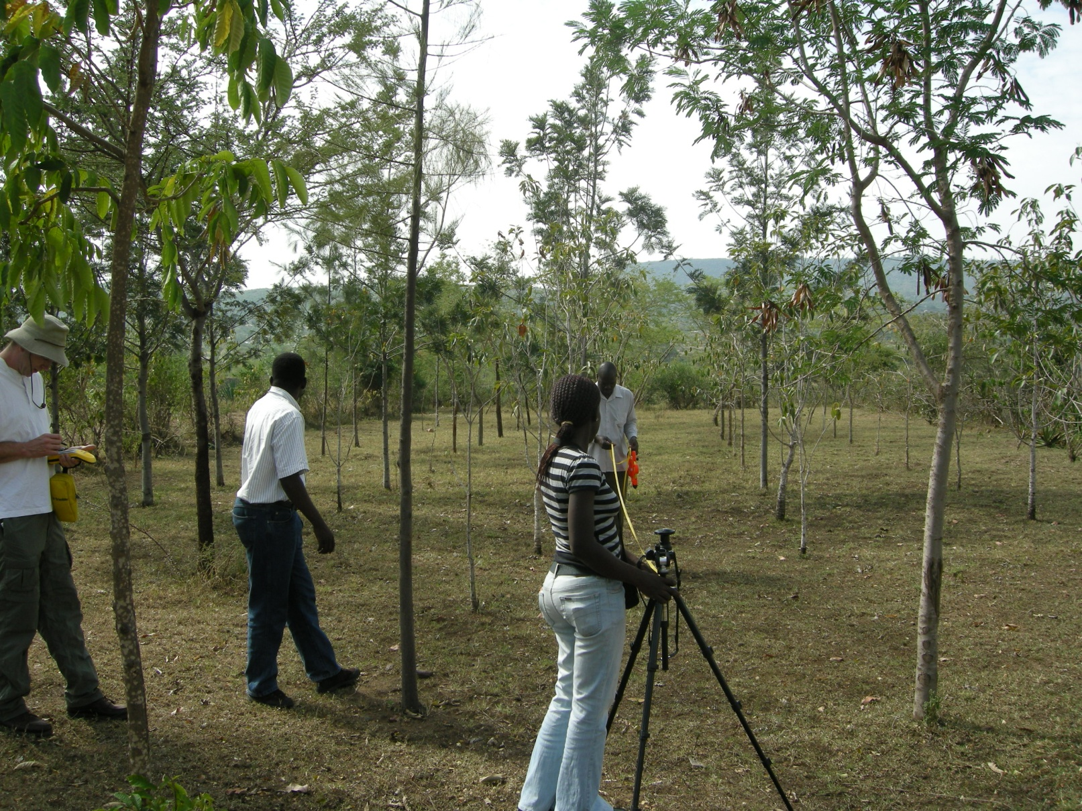
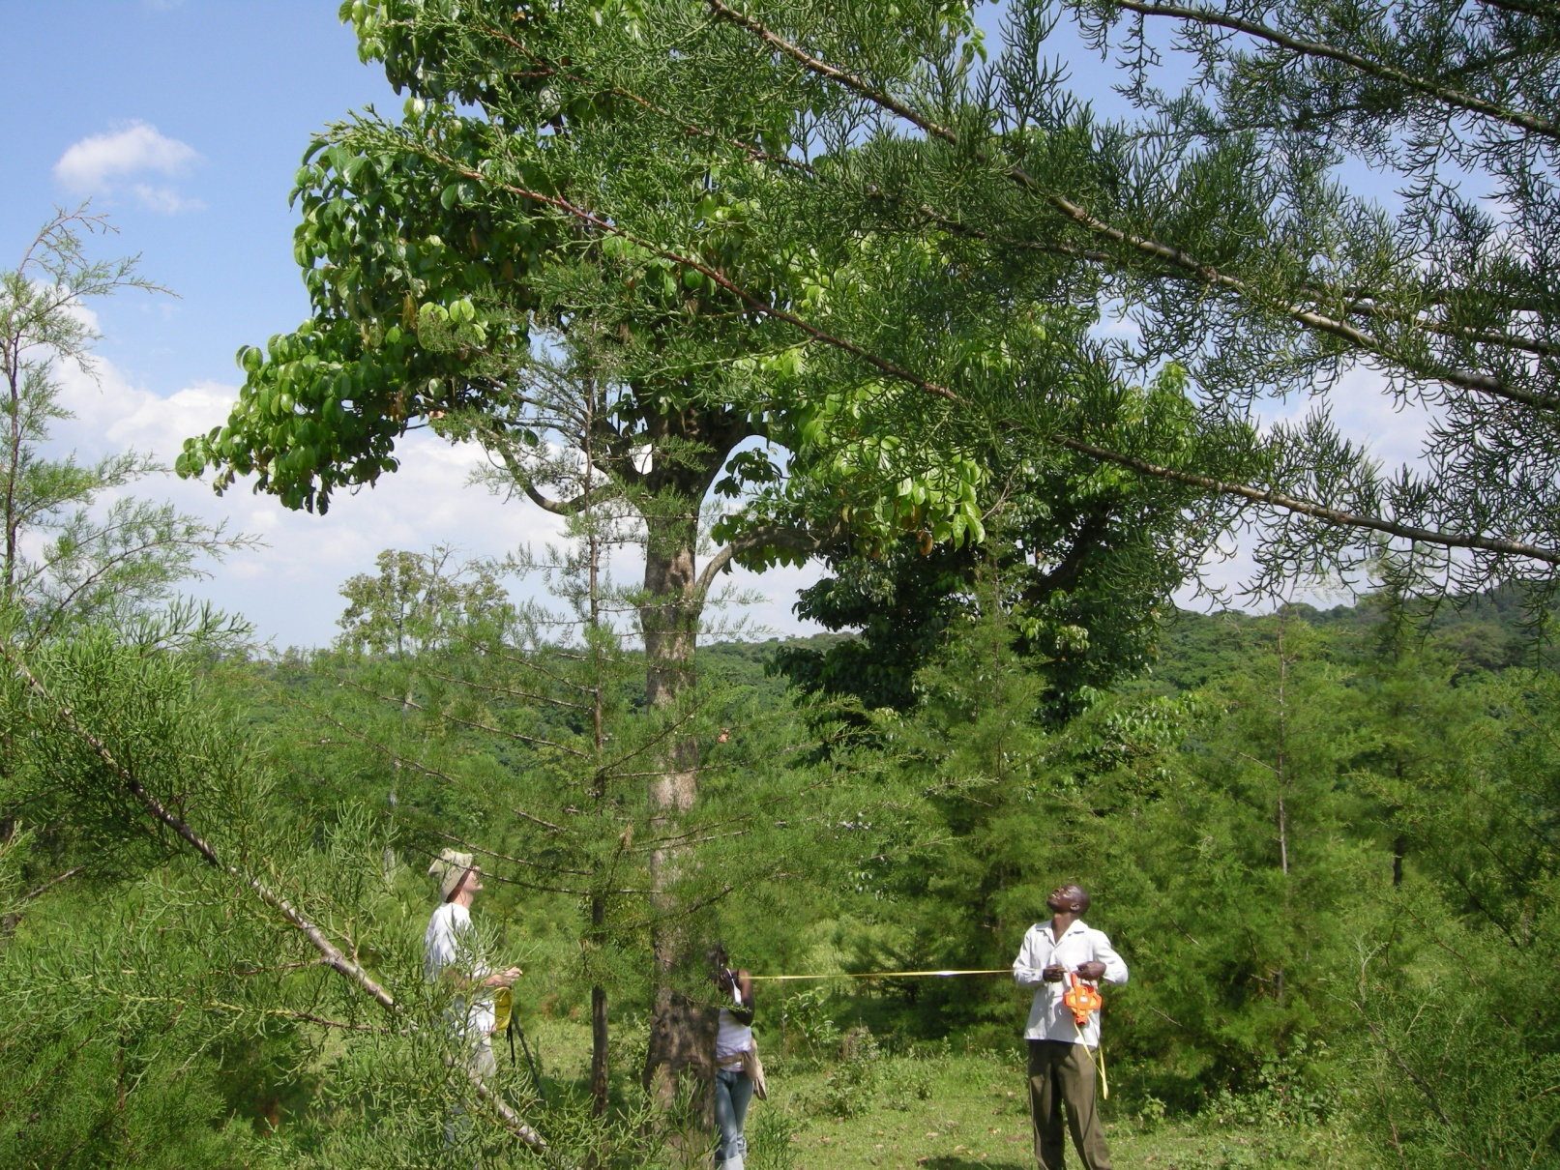
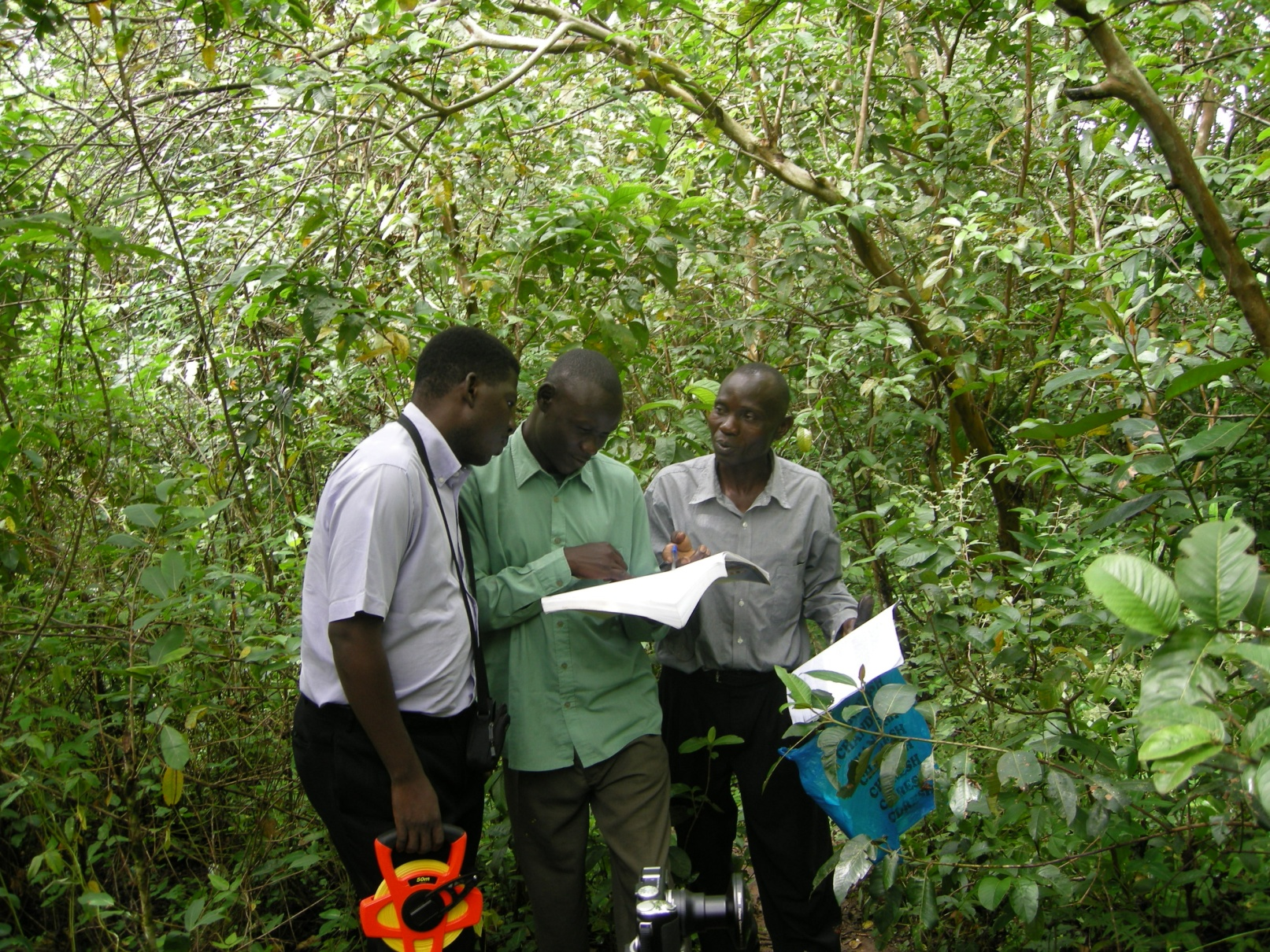
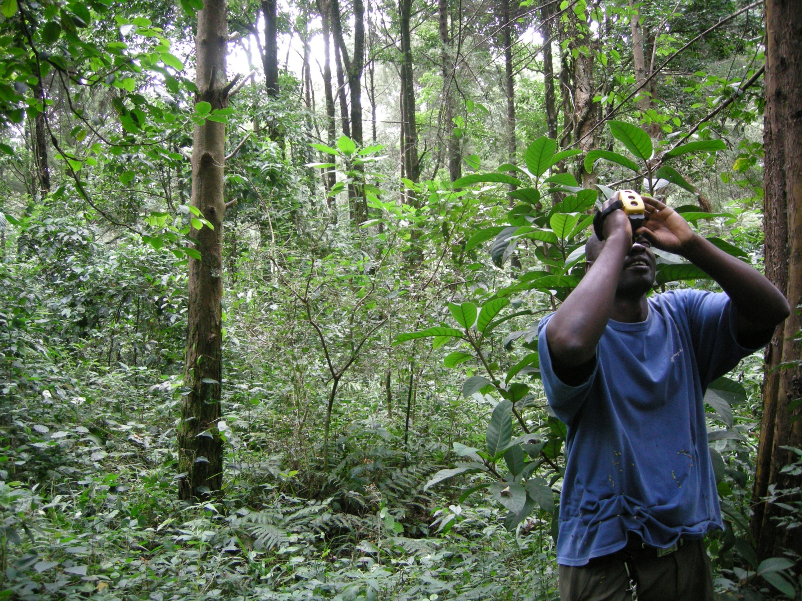
Sample plot in an ICRAF agroforestry demonstration site
Measuring crown radius and recording GPS location
ICRAF and KFS staff identifying a tree species
Measuring tree height with LaserAce hypsometer

Slide 30
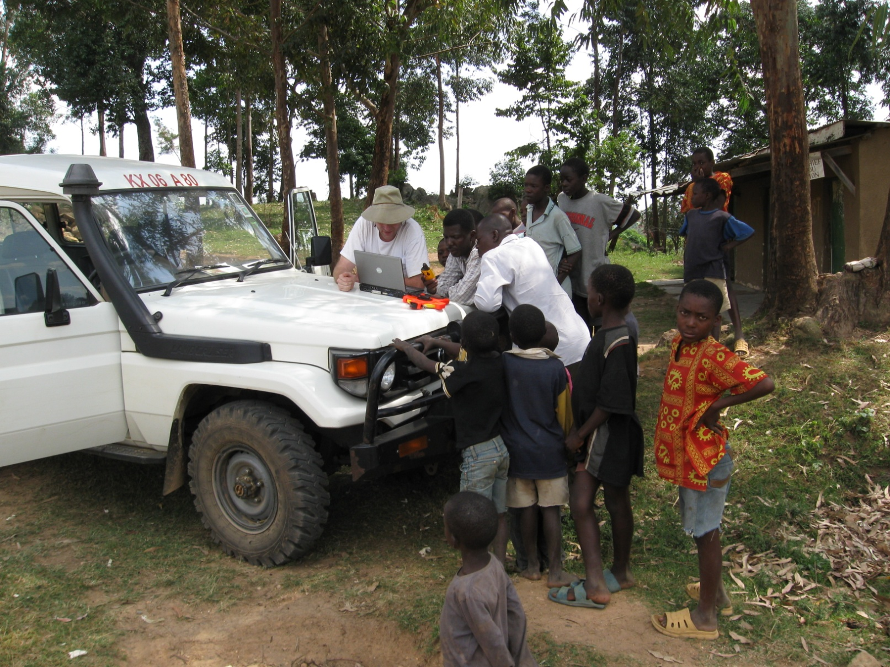
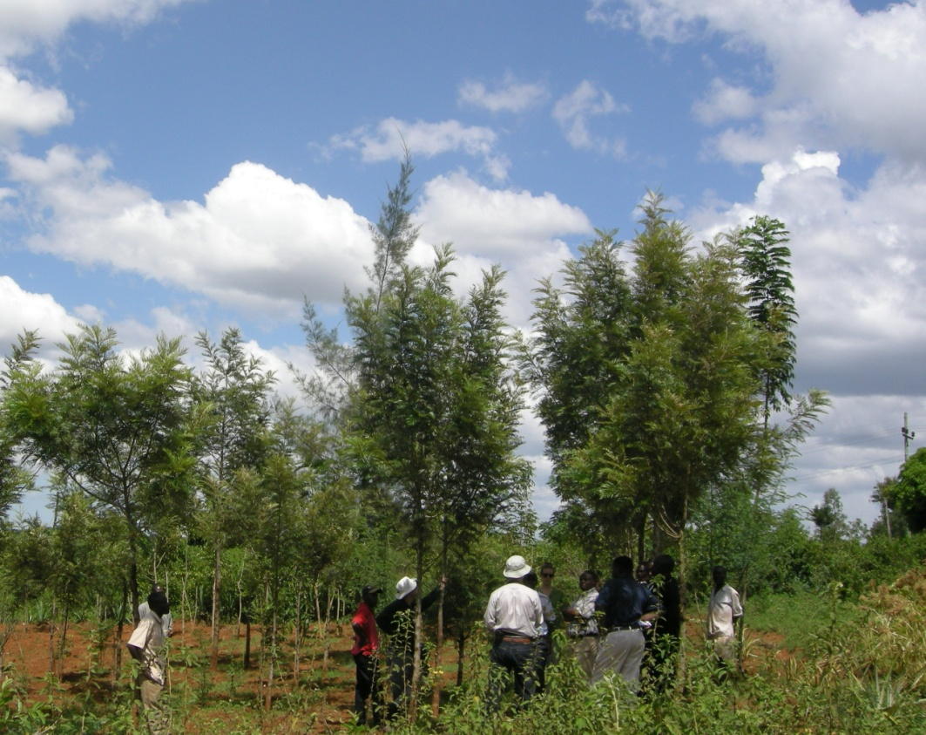
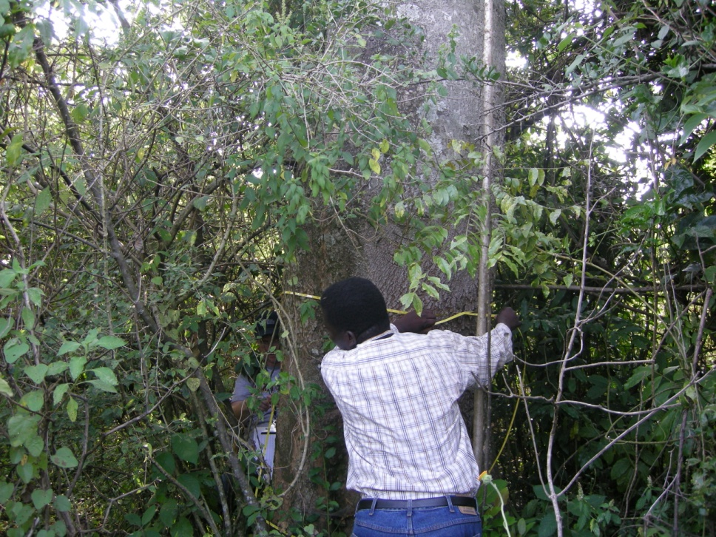
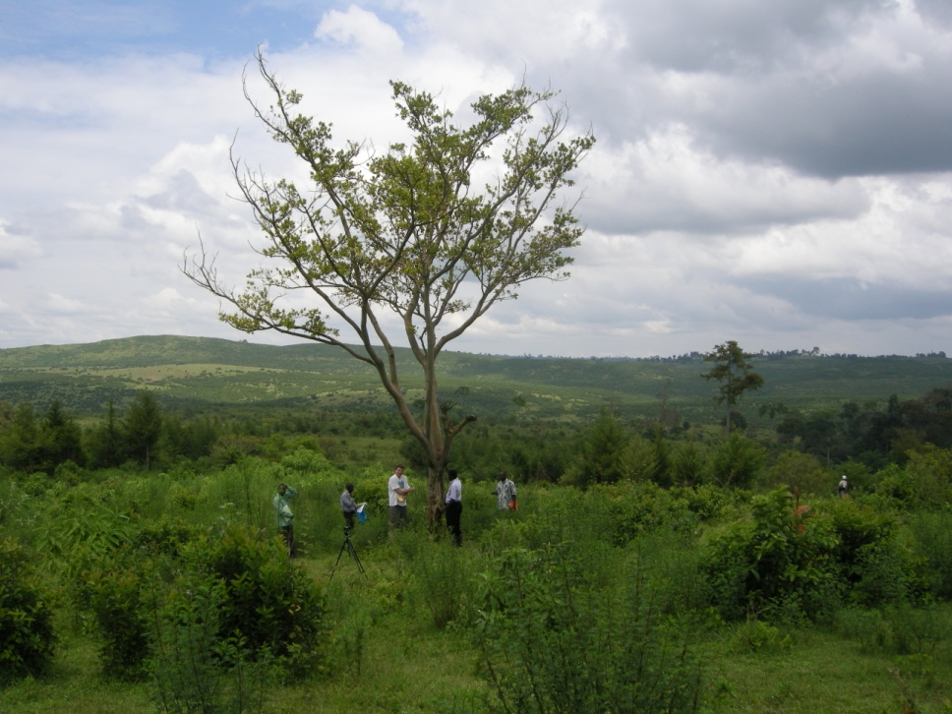
MSU and ICRAF coordinating satellite imagery and GPS
MSU, ICRAF, KEFRI, and UMD Staff discussing carbon
Measuring DBH on a large tree
Measuring crown attibutes

Slide 31
Individual tree crowns on 0.6 m PAN Quickbird image

Slide 32
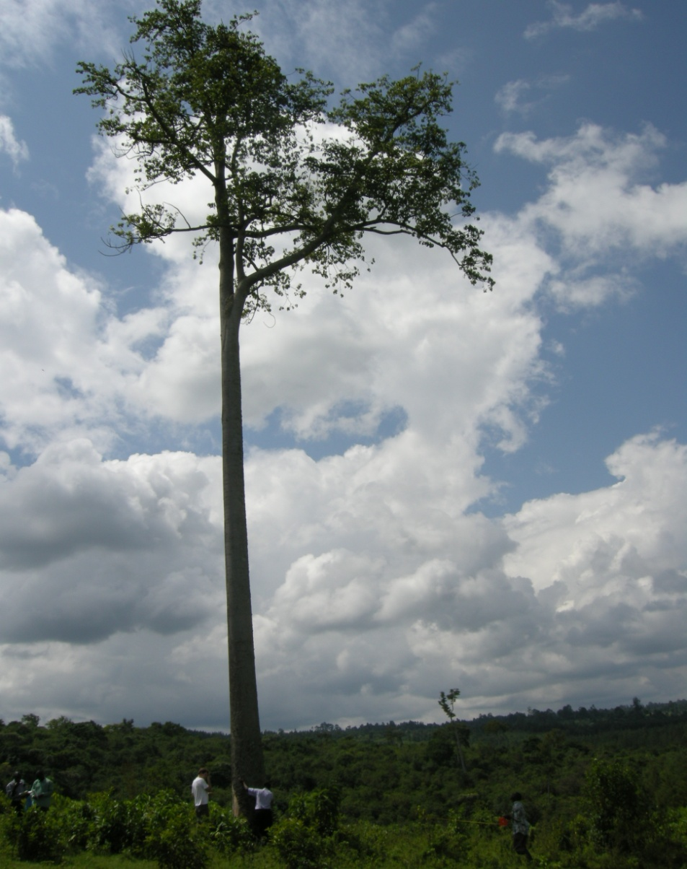
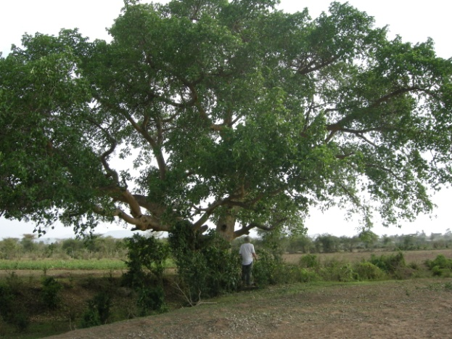

Ficus sycomorus:
129 cm DBH
13 m height
478 m²crown area
24,251 kg ABG
Polyscious fulva:
46 cm DBH
14 m height
172 m²crown area
1,871 kg ABG
Antiaris toxicaria:
89 cm DBH
27 m height
56 m² crown area
9,711 kg ABG

Slide 33
Preliminary estimates of above ground mass, carbon, and CO₂e for individual trees in four crown area categories

Slide 34
Allometric Relationship of Biomass to Crown Area for 136 Individual Trees in Western Kenya
(Ficus – 135 cm, 328 m²)
(Acacia – 64 cm, 360 m² )

Slide 35



Dave MacFarlane, MSU Forestry
- Functional Branch Analysis (FBA) to improve existing allometric equations with local data from standing trees
- Sampling Methods and Protocols
Source: van Noordwijk and Mulia, Ecological Modeling, 149 (2002) 41-51

Slide 36

500 m² fixed area plots at Kibiri Station, Kakamega Forest: natural forest and plantations (Prunus, Pinus, Cupressus, Bischofia)

Slide 37

Fencerow sample plots (Cupressus and Eucalyptus)

Slide 38

Whole farm inventory:
40 trees on 0.81 ha farm and 29 trees on 0.53 ha farm

Slide 39




  Model growth and yield of trees and forests using dendrochronology, local climate data, and wood density measurements
Cupressus lusitanica collected in western Kenya with bimodal rings representing “short rains” in fall and “long rains” in spring (Diameter = 20.2 & 13.5 cm)
Eucalyptus saligna collected in Kenya (Diameter = 11.5 cm)

Slide 40


MSS Quickbird image of farms, fencerows, and forests
Forest / Non-Forest layer
(colors indicate distinct stands not levels of biomass or carbon)

Slide 41
Preliminary estimates of mass, carbon, and CO₂e in above ground woody biomass in 6 land covers in the Yala Watershed

Slide 42


Slide 43
Fire Detections in Western Kenya, 2000 to 2009
MODIS Thermal Anomalies
MOD14
Chris Justice
Tatiana Loboda
Allyssa Whitcraft
University of Maryland
Department of Geography

Slide 44



Slide 45


Slide 46


Slide 47


Slide 48


Slide 49


Slide 50


Slide 51


Slide 52


Slide 53

Thank You

Slide 54


Slide 55

Zoom in at high resolution

Slide 56

Small blue dots are waypopints. White is non forest/trees. Carbon sequestration range: 4-8 tCO2e per ha per yr (light to dark)

